Slide 1
Grades 4 & 5
2. Rainforests

Slide 2
Learning Goals
Identify the four layers of the rainforest.
Use comparative adjectives to describe how each layer looks.
Use prepositions to describe where each layer is.

Slide 3
Activate
Where is the parrot?
The parrot is.....
The parrot is on the table.

Slide 4
Activate
Where is the parrot?
The parrot is.....
The parrot is above the table.

Slide 5
Activate
Where is the parrot?
The parrot is.....
The parrot is under the table.

Slide 6
Activate
Where is the parrot?
The parrot is.....
The parrot is next to the table.

Slide 7
Activate
Where is the parrot?
The parrot is.....
The parrot is in the box.

Slide 8
Activate
Where is the parrot?
The parrot is.....
The parrot is between the box and the table.

Slide 9
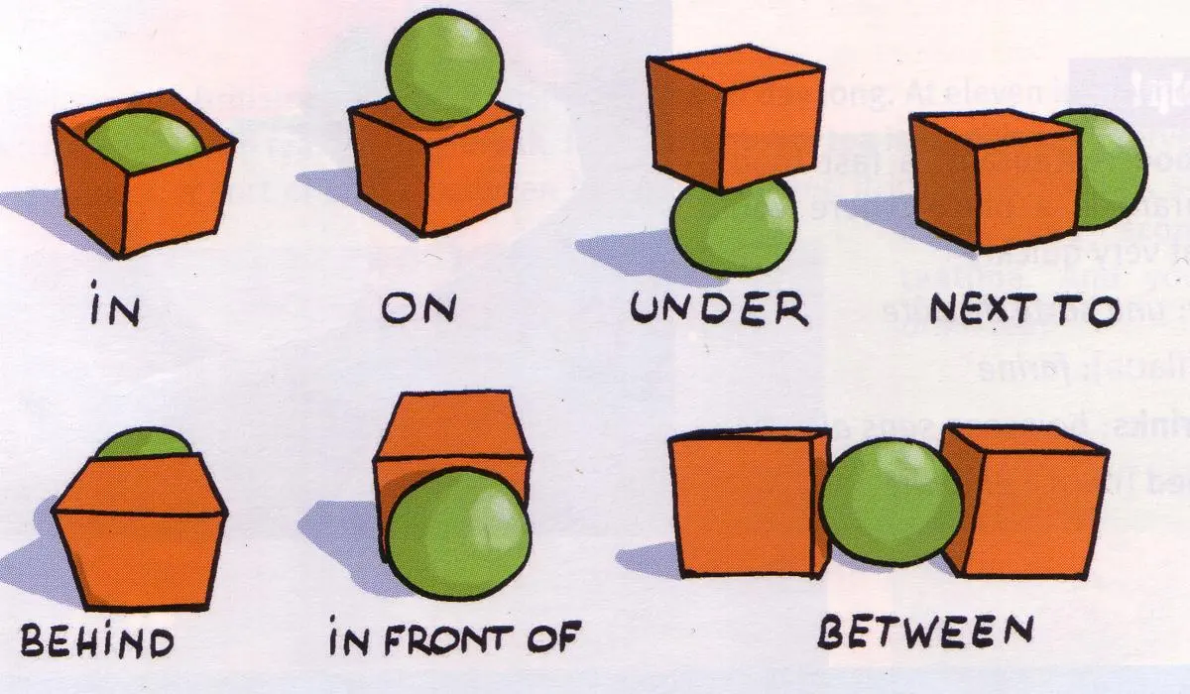
Learn
Look at the prepositions of place.

Slide 10
Learn
How many can you remember?!
Complete as many as you can remember.

Slide 11
Learn
A little help…
on
under
between
behind
in
in front of
next to

Slide 12
Feedback
in
on
under
next to
between
behind
in front of

Slide 13
Activity
Watch the video and write the names of the 4 layers of the rainforest.
Forest floor
Emergent
Understory
Canopy

Slide 14
Check
Emergent
Canopy
Understory
Forest floor

Slide 15
Activity
Read the information of each layer.
Draw a line to match the layer of the rainforest with the description -
A, B, C or D
Look for information and prepositions to help you.
Emergent
Canopy
Understory
Forest floor

Slide 16
Check
Emergent
Canopy
Understory
Forest floor

Slide 17
Learn
Fill-in-the-gap sentences using prepositions of place
The emergent layer is ______ the canopy.
Birds live ______ the tallest trees in the emergent layer.
The canopy is ______ the understory layer.
Many animals live ______ the branches of the trees in the canopy.
The forest floor is ______ the understory.
Monkeys swing ______ the trees in the canopy.
Frogs can be found ______ the leaves of the understory.
Large trees in the emergent layer grow ______ the canopy.
The forest floor is dark because it is ______ all the other layers.
above under in on between next to

Slide 18
Check
Fill-in-the-gap sentences using prepositions of place
above
The emergent layer is ______ the canopy.
Birds live ______ the tallest trees in the emergent layer.
The canopy is ______ the understory layer.
Many animals live ______ the branches of the trees in the canopy.
The forest floor is ______ the understory.
Monkeys swing ______ the trees in the canopy.
Frogs can be found ______ the leaves of the understory.
Large trees in the emergent layer grow ______ the canopy.
The forest floor is dark because it is ______ all the other layers.
in
above
in
under
between
on
above
under

Slide 19
Learn
Fill-in-the-gap sentences using prepositions of place
Ants walk ______ the forest floor looking for food.
The understory is ______ the canopy and the forest floor.
Plants grow ______ the forest floor, reaching for light.
The tallest trees in the emergent layer rise ______ the other layers.
The forest floor is ______ the understory.
Some birds fly ______ the emergent layer, looking for food.
Small plants grow ______ the ground of the forest floor.
above under in on between next to

Slide 20
Learn
Fill-in-the-gap sentences using prepositions of place
on
Ants walk ______ the forest floor looking for food.
The understory is ______ the canopy and the forest floor.
Plants grow ______ the forest floor, reaching for light.
The tallest trees in the emergent layer rise ______ the other layers.
The forest floor is ______ the understory.
Some birds fly ______ the emergent layer, looking for food.
Small plants grow ______ the ground of the forest floor.
between
on
above
under
above
on

Slide 21
Game
Guess Who? Yes or No Questions Only
How?
One student leaves the classroom
Rest of the class QUIETLY decides the type of animal.
Student comes back and begins asking YES or NO questions to find out the type of animal. e.g. “Is it brown?” “Does it have fur?”
Added Challenge:
Can you add a preposition and a noun to your secret answer. e.g. “Monkey under a table.”

